Slide 1
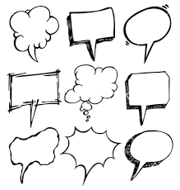
Conversation Cloud
Team 1 Abhinav Ashish, Ira Ramtirth, Mohamed Albashir, Rohit Khilnani, Shalini Sejwani

Slide 2
Objective
Research, prototype and evaluate a software tool that listens to conversations, then produces a visual souvenir of that conversation.
Client: Vidya Setlur at Tableau Software

Slide 3
Research
Desirable Properties of Visual Souvenirs
Evoke Familiarity – location, time of day Can be logged while recording the conversation
Obscure Sensitive Data – age, financial data Can preprocess the conversation before generating sketches
Expressing Subjectivity – Customizable Visuals Can make the sketches customizable
Split the conversation into episodes (like video summarization) Can preprocess the conversation to divide it into chunks
Identification of actors Can use speaker recognition to identify actors
Auto and/or manual tagging of visual(s) For organization

Slide 4
Example Conversation
Conversation about a good night sleep between a mother and her daughter.
Summary of conversation (1384 words in original transcript):
Some family members are too tired due to a lot of travel, but pretending to watch TV at night
How sometimes people are at parties late night, wanting to sleep but cannot escape
Sleeping on time vs sleeping late. Effect of drinking/ eating food before sleeping
Getting up at mid night and using restroom or starting their coffee maker

Slide 5
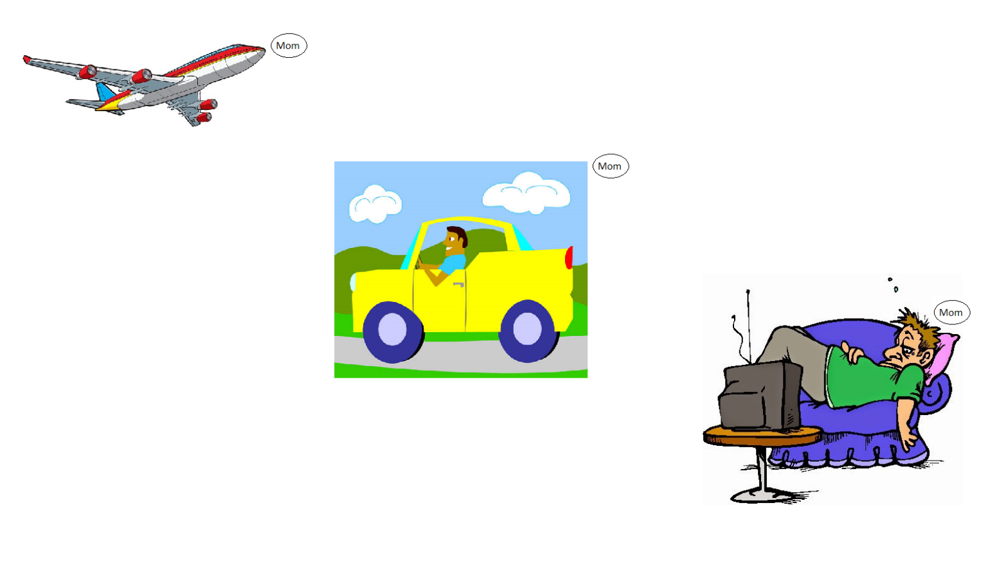
Sketch 1
Episode 1

Slide 6
Sketch 1
Identifies the speaker associated with the visual
Episode 1

Slide 7
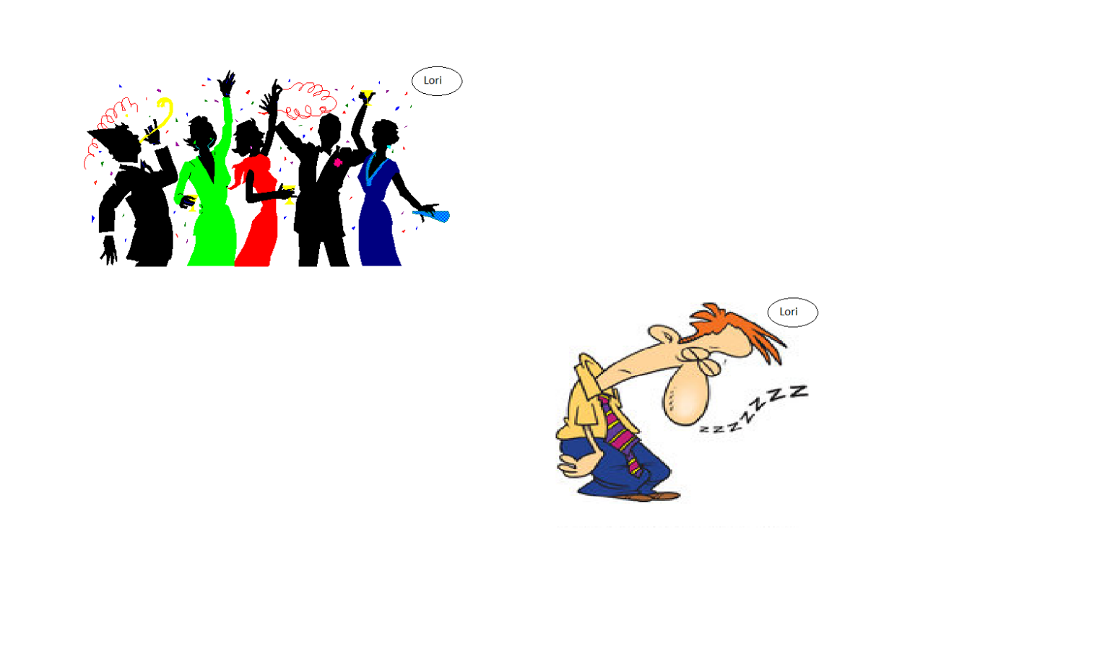
Sketch 1
Episode 2

Slide 8
Sketch 1
This part was associated with Lori
Episode 2

Slide 9
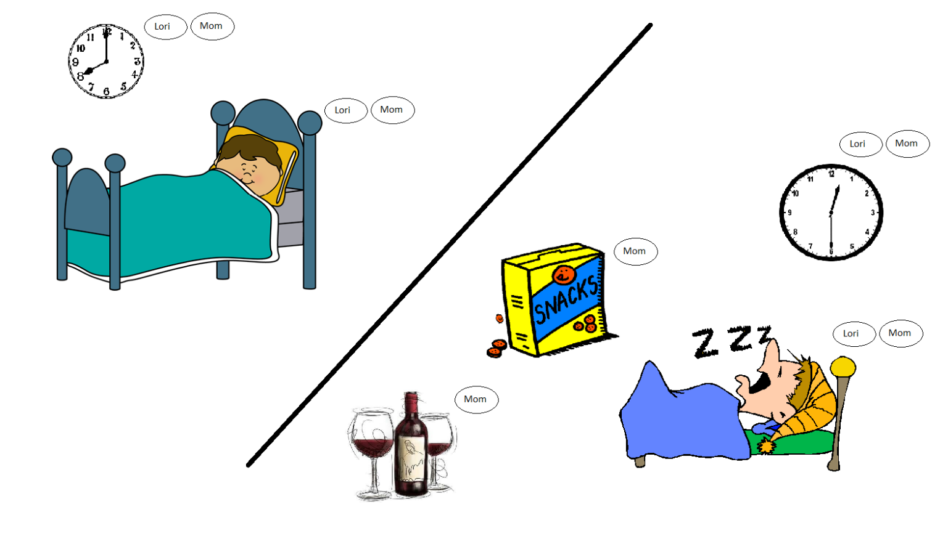
Sketch 1
Episode 3

Slide 10
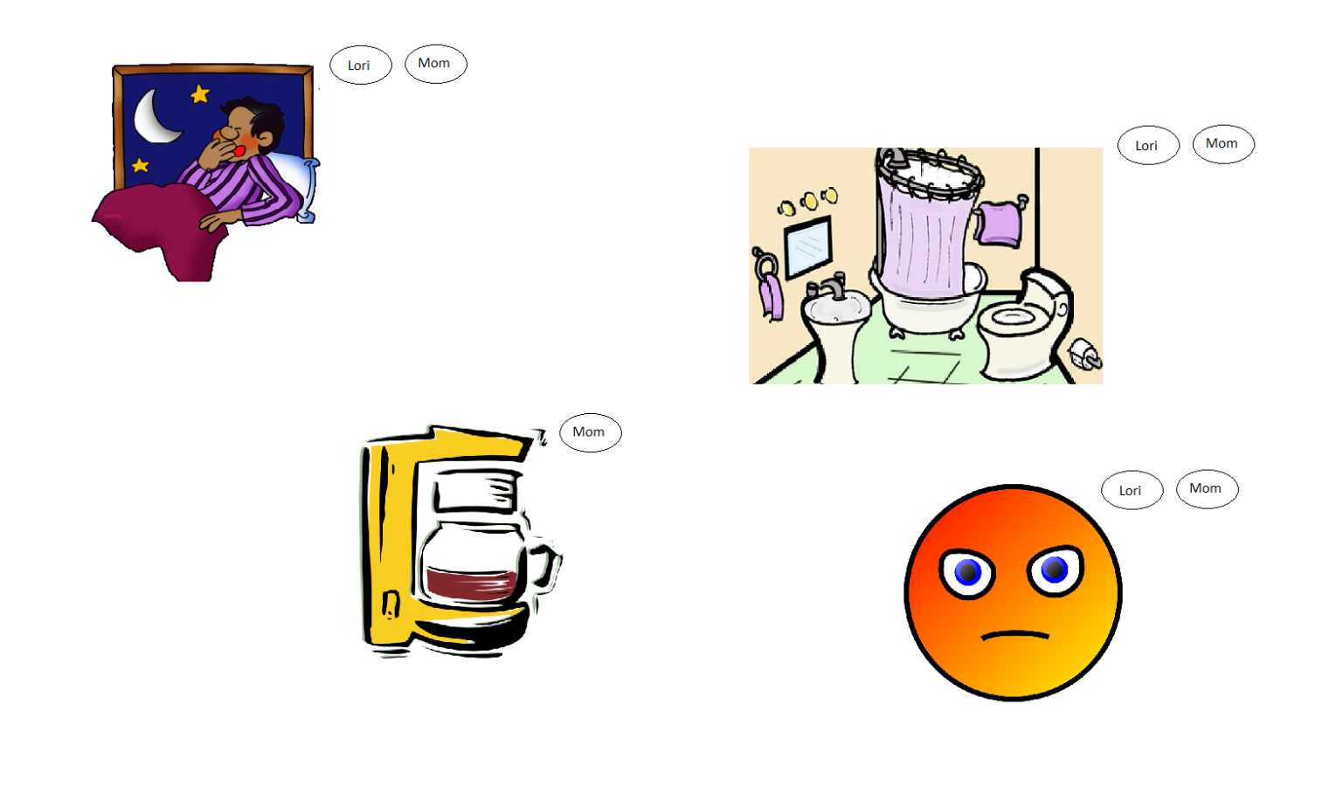
Sketch 1
Episode 4

Slide 11
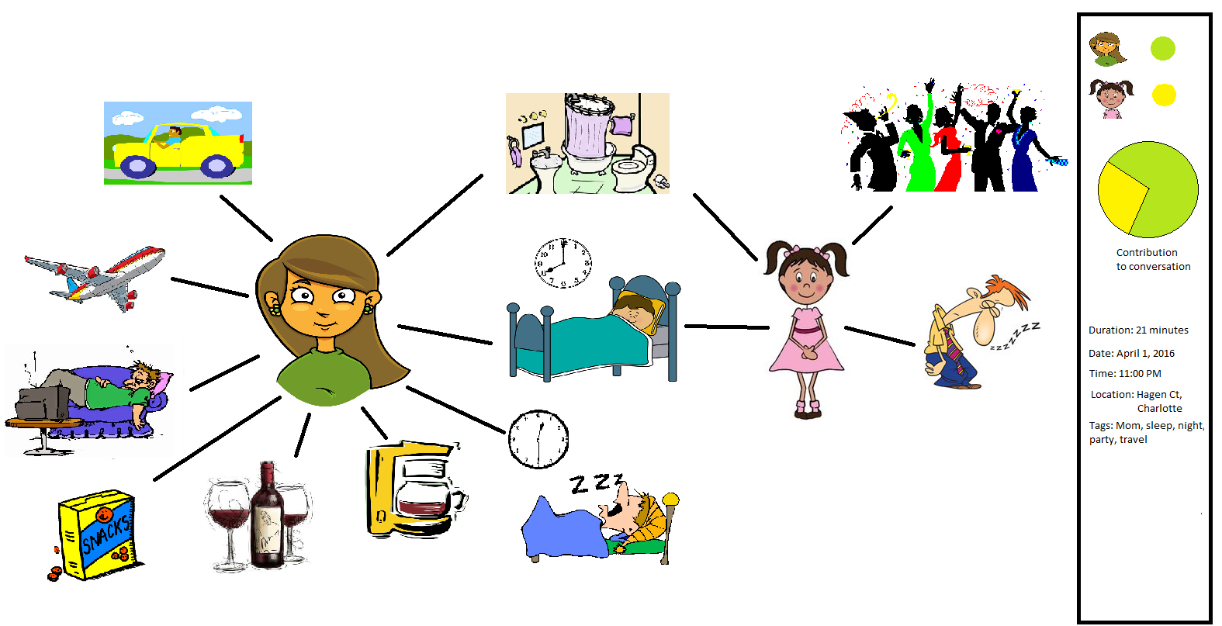
Sketch 2

Slide 12
Sketch 2
Speaker

Slide 13
Sketch 2
Speaker
Mini Dashboard

Slide 14
Critiques
Conversations too short
Concrete algorithm
How will you identify who spoke what?
When/ Where did the conversation take place ?
How will you relate conversations?
How will you show the conversations in an application?

Slide 15
Critiques
Conversations too short – Considered Long conversation
Concrete algorithm
How will you identify who spoke what?
When/ Where did the conversation take place ?
How will you relate conversations?
How will you show the conversations in an application?

Slide 16
Critiques
Conversations too short – Considered Long conversation
Concrete algorithm – Not what client is looking for
How will you identify who spoke what?
When/ Where did the conversation take place ?
How will you relate conversations?
How will you show the conversations in an application?

Slide 17
Critiques
Conversations too short – Considered Long conversation
Concrete algorithm – Not what client is looking for
How will you identify who spoke what? – Bubbles/Edges
When/ Where did the conversation take place ?
How will you relate conversations?
How will you show the conversations in an application?

Slide 18
Critiques
Conversations too short – Considered Long conversation
Concrete algorithm – Not what client is looking for
How will you identify who spoke what? – Bubbles/Edges
When/ Where did the conversation take place ? – Properties of conversation (like SMS)
How will you relate conversations?
How will you show the conversations in an application?

Slide 19
Critiques
Conversations too short – Considered Long conversation
Concrete algorithm – Not what client is looking for
How will you identify who spoke what? – Bubbles/Edges
When/ Where did the conversation take place ? – Properties of conversation (like SMS)
How will you relate conversations? – By common tags
How will you show the conversations in an application?

Slide 20
Critiques
Conversations too short – Considered Long conversation
Concrete algorithm – Not what client is looking for
How will you identify who spoke what? – Bubbles/Edges
When/ Where did the conversation take place ? – Properties of conversation (like SMS)
How will you relate conversations? – By common tags
How will you show the conversations in an application? – By topic, people, tags, location or time

Slide 21
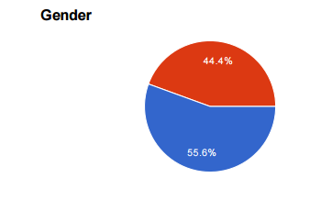
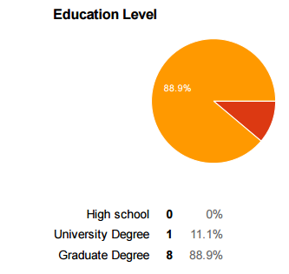
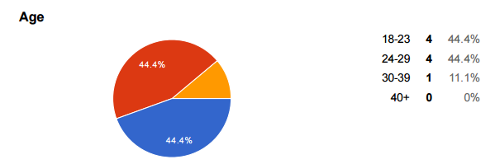
Survey Results
Demographics

Slide 22
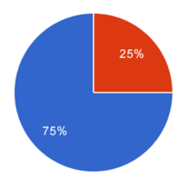
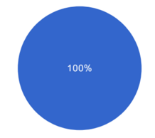
Survey Results
Sketch Questionnaire Do you think the entire conversation was represented?
Sketch 1 (Episodes) | Sketch 2 (Single Visual)

Slide 23
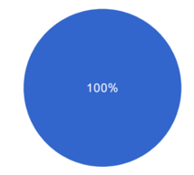
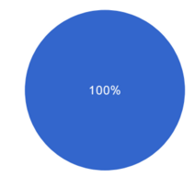
Survey Results
Sketch Questionnaire After seeing the visual do you think you were able to recall the conversation?
Sketch 1 (Episodes) | Sketch 2 (Single Visual)

Slide 24
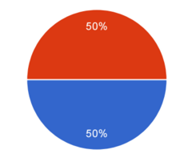
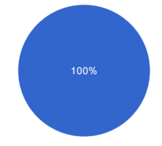
Survey Results
Sketch Questionnaire Did you clearly understand which part of the visual was associated with which actor in the conversation?
Sketch 1 (Episodes) | Sketch 2 (Single Visual)

Slide 25
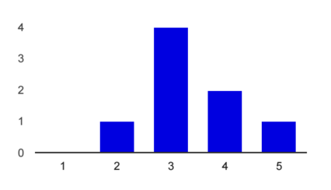
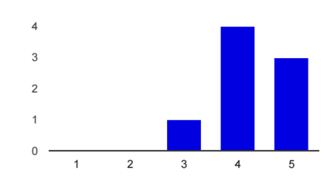
Survey Results
Sketch Questionnaire Rate the visual appeal of the sketch?
Sketch 1 (Episodes) | Sketch 2 (Single Visual)

Slide 26
Survey Results
Sketch Questionnaire Was there something that you did not like?
Sketch 1 (Episodes) I felt it was long it was somewhat complex, but I thought it was intuitive It's fairly long, I could just read a transcript, and remember what I talked about | Sketch 2 (Single Visual) its complicated I liked the visual I actually liked this one even more than the other. maybe how complex the visual got, even though its just two people talking the visual wasn't that great

Slide 27
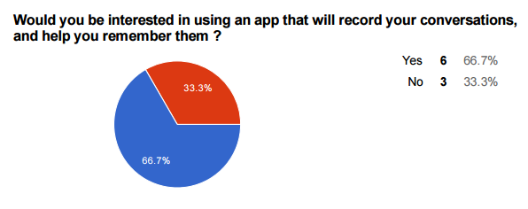
Survey Results
Pre Usage

Slide 28
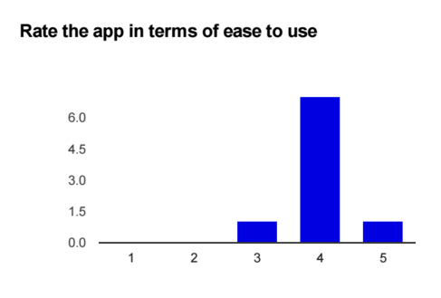
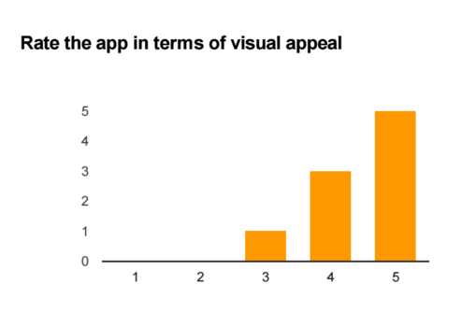
Survey Results
App Questionnaire

Slide 29
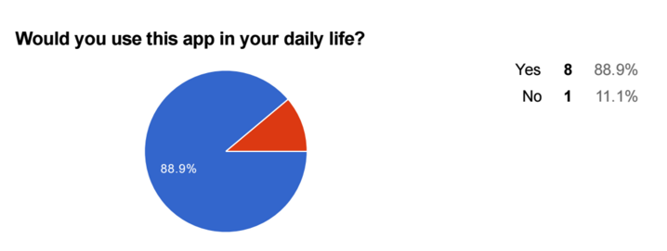
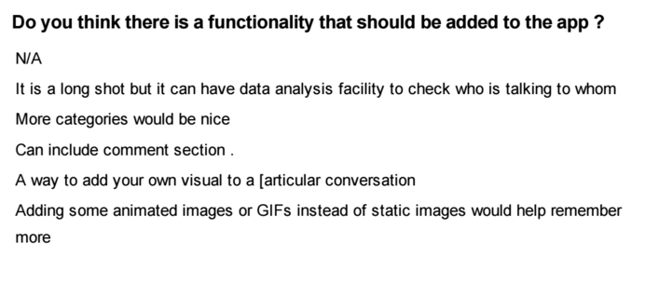
Survey Results
App Questionnaire

Slide 30
Limitations
Sketch 1 (Episodes) Found Less Appealing by subjects Difficult to show emotion associated with speakers Takes time to scroll through the various episodes | Sketch 2 (Single Visual) Could become complex for large number of speakers Could become less effective for long conversations due to limited space (single visual) Lack of ordering of events

Slide 31
Recommendations
Such an application must:
evoke familiarity
obscure sensitive data
allow souvenirs/sketches to be customizable (proven to help recall)
be capable of handling long conversations by dividing it into episodes
have auto-tagging of souvenirs and allow manual tagging for customization
have automatic speaker recognition

Slide 32
Thank You
Questions?

